Slide 1
Exploratory Data Analysis using Python
LAPTOP-DATASET
Sreejaa R G
DA & DS
May-2025
21-07-2025

Slide 2
Table of content
Overview
Key Attributes / Variables
Data Cleaning
EDA
Univariate Analysis
Bivariate Analysis
Multivariate Analysis
Outlier
Statistical Analysis
Descriptive Analysis
Conclusion and Recommendations

Slide 3
Overview
This project focuses on the exploratory and statistical analysis of a laptop dataset to understand the key factors that influence laptop pricing and consumer preferences. With laptops being a widely used technological product across various user groups — including students, professionals, and gamers — it is essential to understand how different features affect pricing and buying behavior.
The dataset includes technical specifications such as screen size, RAM, processor type, storage type, weight, and operating system, along with brand and price information. By cleaning, visualizing, and analyzing this data, the project aims to extract actionable insights into market trends, pricing strategies, and consumer choices.

Slide 4
Key Attributes / Variables
Company: The brand or manufacturer of the laptop (e.g., Dell, HP, Apple).
TypeName: The category or type of laptop (e.g., Ultrabook, Gaming, Notebook).
Inches: The size of the laptop screen, measured diagonally in inches.
ScreenResolution: The display resolution (e.g., 1920x1080, 1366x768), indicating screen clarity and quality.
Cpu: Information about the processor, including brand, series, and generation (e.g., Intel Core i5 8th Gen).
Ram : The amount of RAM (system memory), typically in gigabytes (e.g., 4GB, 8GB, 16GB).
Memory: The storage capacity and type (e.g., 1TB HDD, 512GB SSD, or hybrid options).
Gpu: The graphics processing unit, which may be integrated or dedicated (e.g., Intel UHD, Nvidia GTX).
OpSys: The operating system installed on the laptop (e.g., Windows 10, macOS, Linux).
Weight_kg: The physical weight of the laptop, usually given in kilograms.
Price: The selling price of the laptop, which is the target variable for analysis.

Slide 5
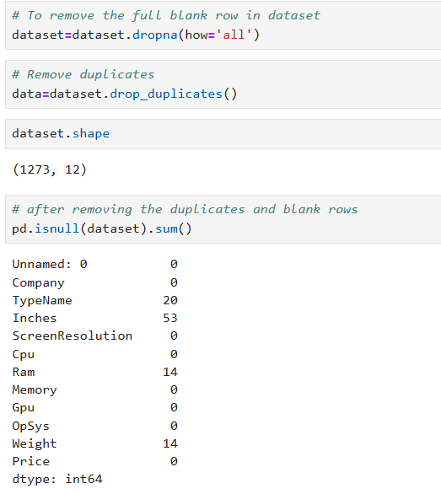
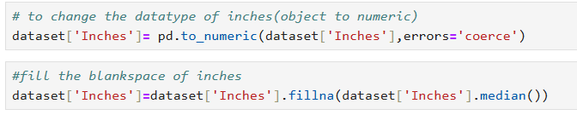
Data cleaning
Steps Taken for Cleaning
Remove the blank rows
Removing Duplicates
Fill the blank spaces with (mean , median , mode)
Data Type Conversion
Remove unwanted column

Slide 6
EDA
EDA stands for Exploratory Data Analysis. It is the process of analyzing and visualizing data to:
Understand the structure and contents of a dataset
Identify patterns, trends, or relationships
Detect missing values, outliers, or errors
Prepare data for further analysis or machine learning

Slide 7
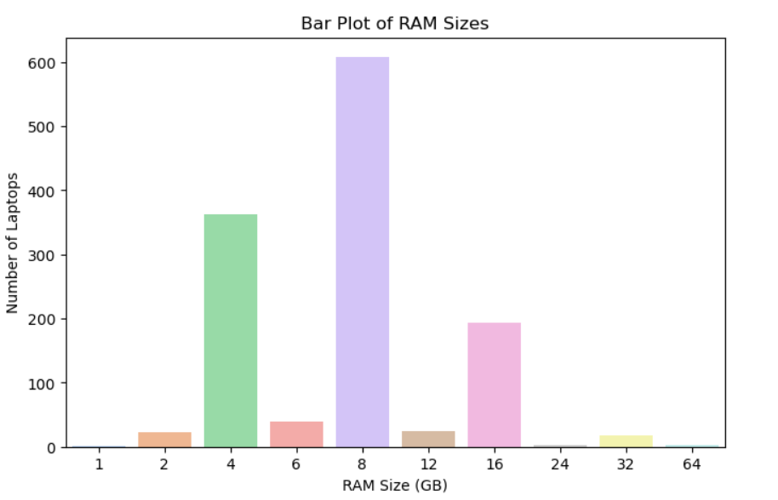
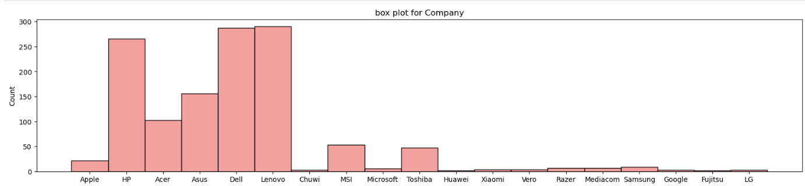
Univariate Analysis
Univariate analysis is the simplest form of data analysis where only one variable is analyzed at a time.
Example:
Ram
Price

Slide 8
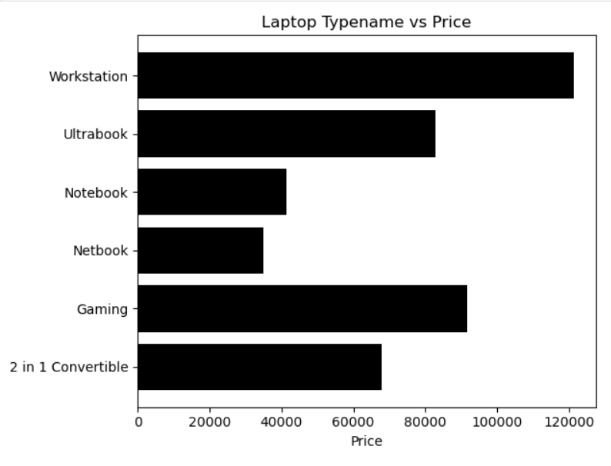
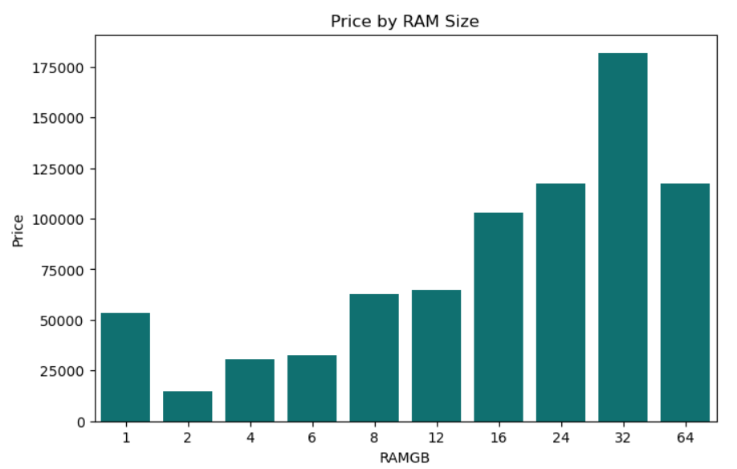
Bivariate Analysis
Bivariate analysis means studying two variables at the same time to see if they are related.

Slide 9
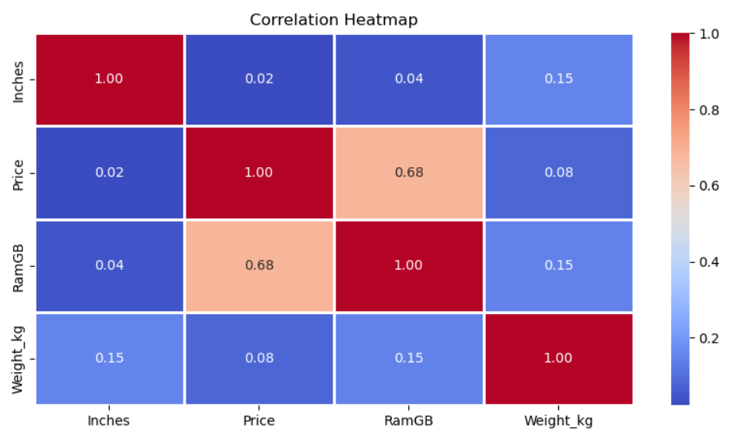
Multivariate Analysis
Multivariate means involving more than two variables at the same time.
In data analysis and statistics, multivariate analysis studies relationships and patterns among three or more variables simultaneously, to understand how they interact with each other.

Slide 10
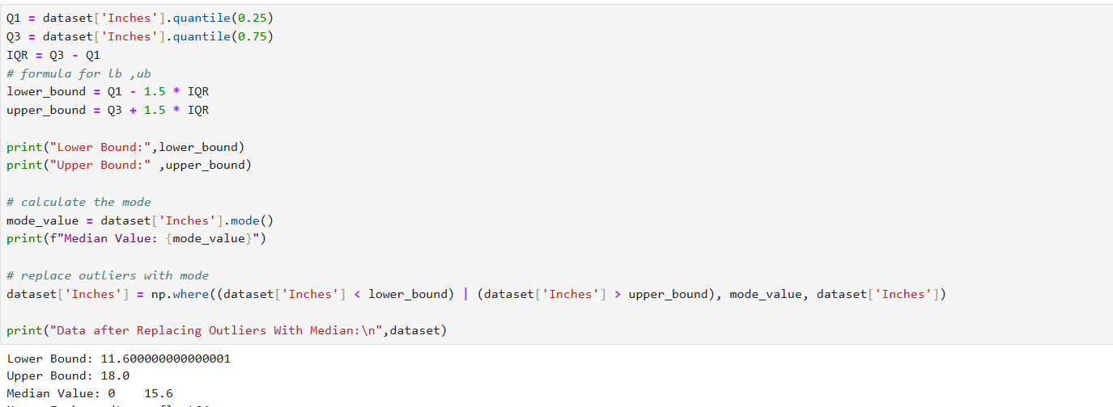
Outlier Handling
An outlier is a value that is too high or too low compared to most of the other values.

Slide 11
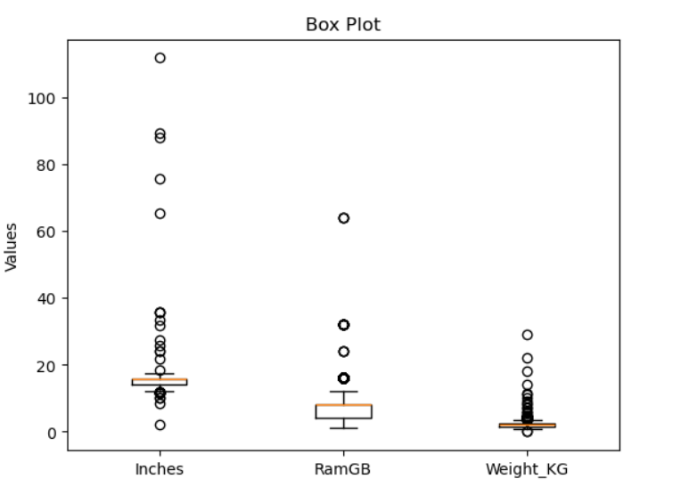
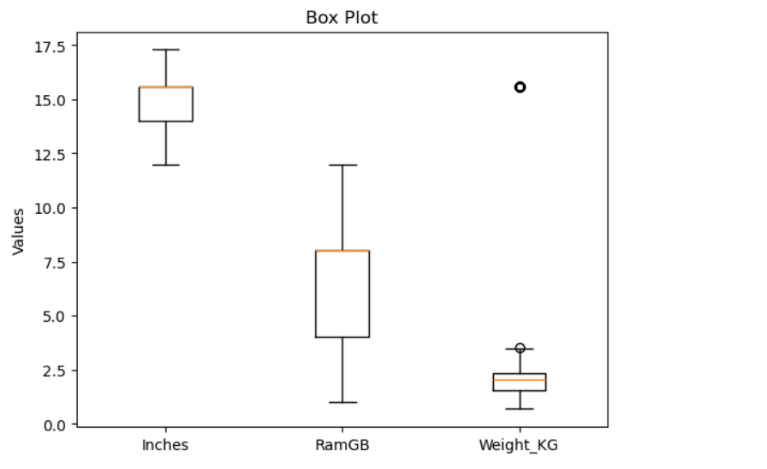
Before remove outlier
After remove outlier

Slide 12
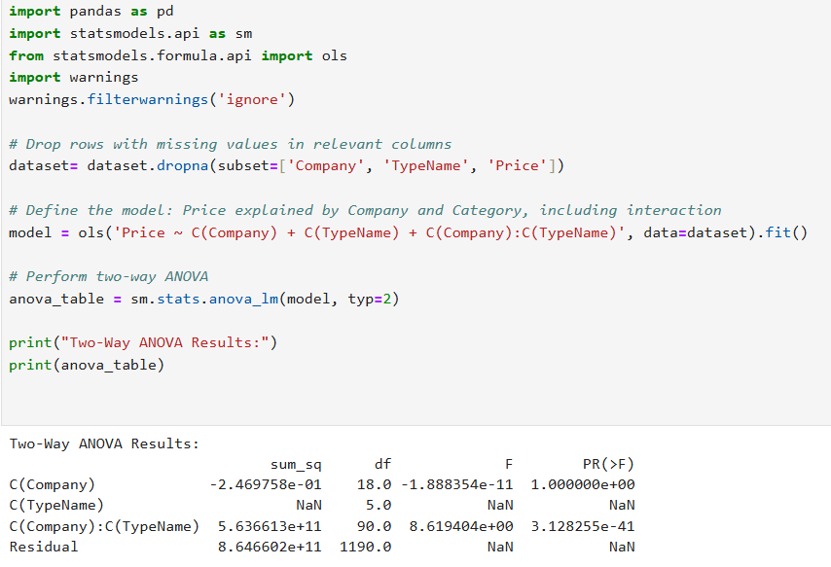
Statistical Analysis
Two-Way ANOVA
Two-Way ANOVA (Analysis of Variance) is a statistical method used to examine the effect of two independent categorical variables (called factors) on one continuous dependent variable.
It also checks whether there is an interaction between the two factors — that is, whether the effect of one factor depends on the level of the other factor.

Slide 13
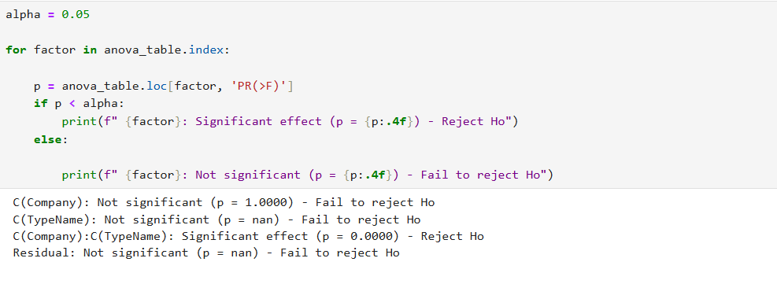

Slide 14
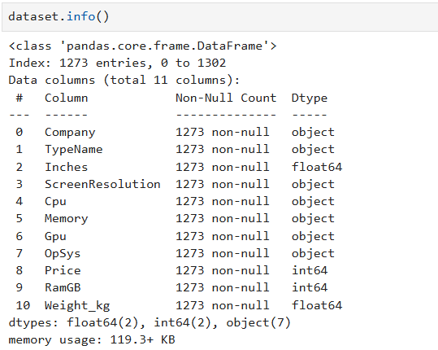
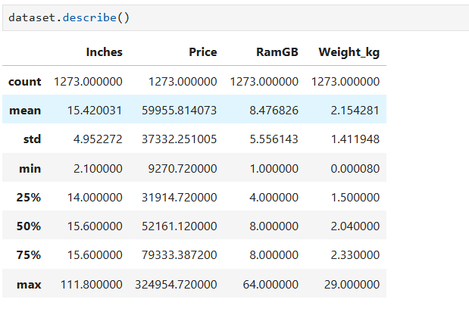
Descriptive Analysis
Info()
Gives a summary of the dataset structure:
Total rows and columns
Column names and data types
Non-null (filled) values
Describe()
Gives summary statistics for numerical columns:
Mean, Median, Min, Max
Standard deviation
25%, 50%, 75% values (quartiles)

Slide 15
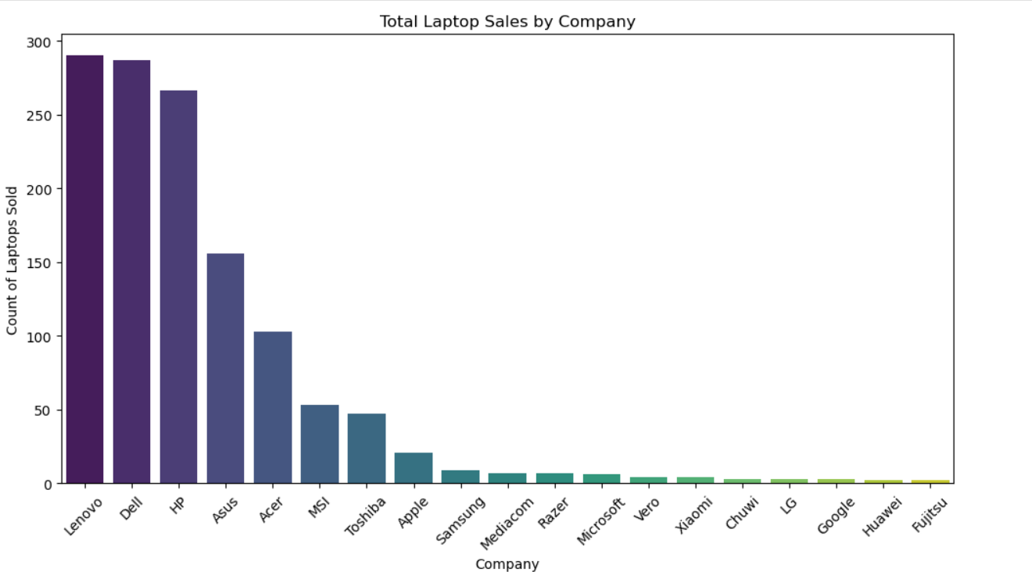
Conclusion and Recommendations
Laptops with 32 GB RAM are the most sold among all configurations.
Laptops with 2 GB RAM have the lowest sales
Top-Selling Company:
The company with the highest number of laptop sales is e.g., HP / Dell / Lenovo].

Slide 16
THANK YOU

